Slide 1
eGUI
Freescale embedded graphic user interface driver
Petr Gargulak
System Application Engineer
Version 3.00
May 20, 2012
Notes:
My name… arrive from CZ to introduce new powerful low-end graphic driver eGUI
I’m Freescale app engineer

Slide 2

Agenda
Introduction
SW structure
Graphics objects
Support software
Extras
eGUI
Notes:
Skip this

Slide 3
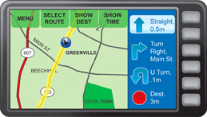


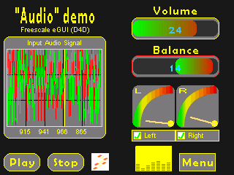
Freescale graphic solutions
Swell - PEG: C, C+, PRO
Advanced graphics features
Screen designer (WindowBuilder)
Touch screen support
Windows Font and Bitmap creator
Multiple platform support
MCU Performance
i.MX
Mobile GT
eGUI
(D4D)
Lightweight graphic driver
Low system requirements (memory, CPU, etc)
Is Free !
ColdFire 3/4
Kinetis
ColdFire 1/2
HCS12
HCS08
Mobile GT + i.MX implementations recommended for LCD testing ($0)
Notes:
eGUI is targeted to low-end Freescale micro roadmap
Slide also is showing it with PEG graphic sw
Its free

Slide 4
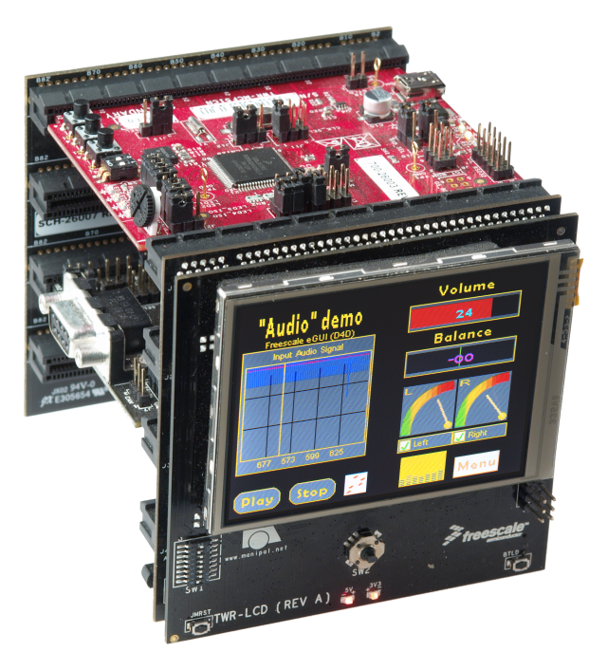
What’s the Freescale Embedded GUI
High level object graphic driver for color LCD
Structure of driver brings complete sw solution for applications with LCD screen
Touch screen capability
Organization done by screen with objects
The source code is using prefix “D4D”( Driver for Display)by historical reasons.
Notes:
Rephrase last sentence

Slide 5
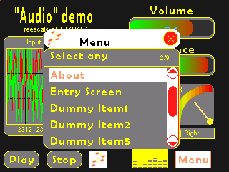
eGUI Features
Support for graphical color LCD displays
Easily ported to any Freescale MCU or MPU
Object style of driver (in C language)
Very smart support screen oriented structure of user code
Compounded objects (objects can be owner of child objects)
Embedded graphic objects (widgets)
Round corners support
Touch screen support
Multiple font support (UNICODE)
External Font Support
Buffer for input keys
Screen history capability
Transparent color / various types of color systems
Can be integrated with MQX operating
system
Notes:
For color LCD
Easy porting
Contains basic widgets – will be more
Touch / round corners
Fonts
Keyboard handling
MQX integration

Slide 6
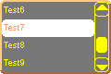
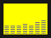
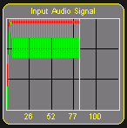


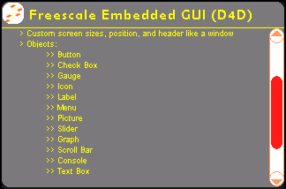
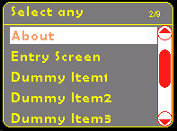


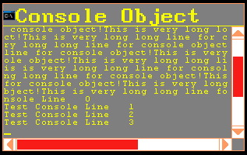
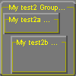
eGUI Features – Graphic objects( Widgets 17pcs)
Button
Check Box
Radio Button
Gauge
Icon
Label
Menu
Picture
Slider
Graph
Text Box
Scroll Bar
Console
Progress Bar
Group Box
List Box
Edit Box
Notes:
List of widgets

Slide 7
eGUI History
eGUI v1.20
MobileGT LCD MPU MPC5225
D4D v0.9
First release (some code packed in libraries)
HCS08
ColdFire V1
ColdFire V2
eGUI v2.21
External data support (bmp, strings)
3D Buttons
eGUI v2.00
Kinetis support
IAR 6.1 compatibility
Round corners support
Q4 2009 | Q1 2010 | Q2 2010 | Q3 2010 | Q4 2010 | Q1 2011 | Q2 2011 | Q3 2011 | Q4 2011 | Q1 2012 | Q2 2012
eGUI v3.00
Compounded objects
Chinese character support / external fonts
Group/List/Edit Box
Various color systems
K70/PXD/CRTOUCH support
Transparent color
eGUI v1.11
Frame buffer driver
MCF52277 support
D4D->eGUI
D4D is used in source code
eGUI is marketing name
eGUI v1.0
Renamed D4D to eGUI
MQX interoperability
HCS12
eGUI v2.10
CW 10 compatibility
Notes:
New version

Slide 8
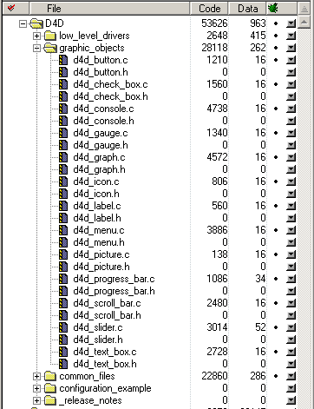
Freescale eGUI driver memory footprint
The worst case is about 54KB Flash / ~194 B RAM:
all objects used
round corners are enabled
bitmap decoders
Same project without round corners and some bitmap decoders is 45KB (still all objects)
Typical footprint – 45KB
Notes:
The very small memory footprint

Slide 9
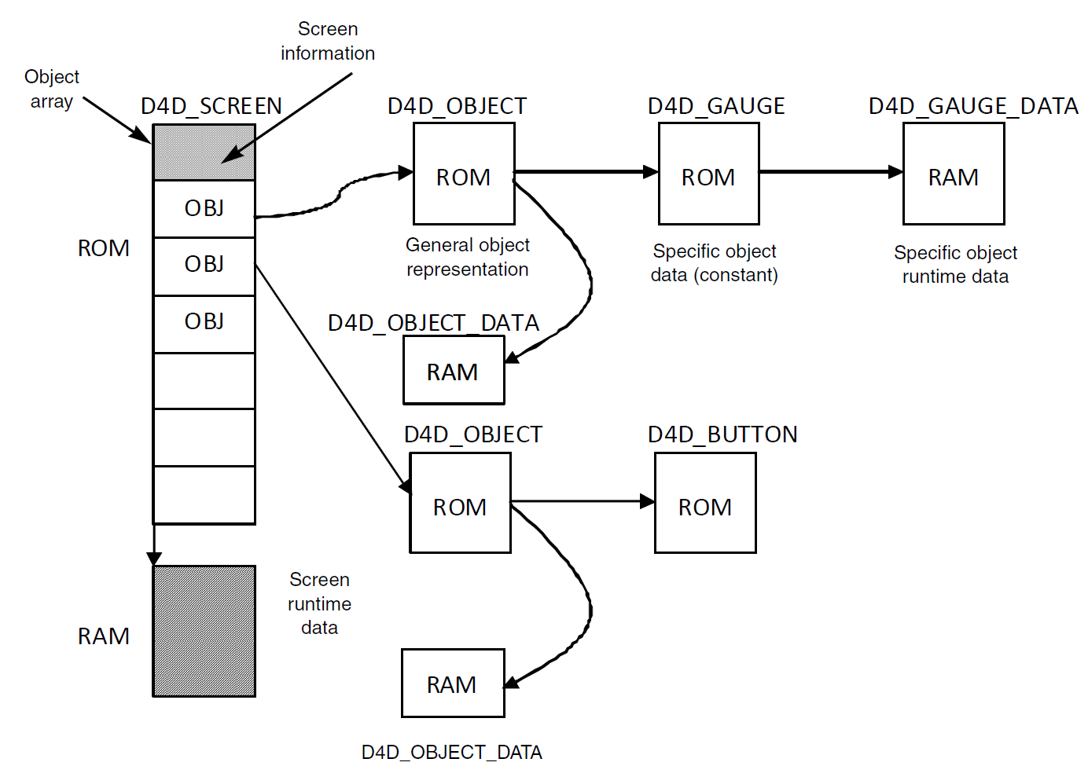
eGUI Memory optimization
The eGUI is highly optimized in RAM use.
ROM – all static data
RAM – only variables
The ROM/RAM ratio is usually about 90% or better to describe most objects.
Screen
Gauge object
Button object
Notes:
This slide showing us that eGUI is mostly using the ROM to save RAM. 90%

Slide 10
eGUI Support Both Types of LCD Driving Methods
Traditional LCD System
Requires a MPU with LCD controller
SPI/Parallel driven LCD
Can be driven from any MCU
MPU
LCD
Controller
RGB
LCD bus
MCU
SPI / Parallel
Address and data bus
Display DRAM
Supported:
Coldfire - MCF5227x
MobileGT – 5125
Chip on glass LCD
with integrated
display RAM
Program Flash
Notes:
Universal low level that support both types of LCD driving methods

Slide 11
Existing eGUI examples (v2.10)
Board Name | MCU Type | LCD Controller | Interface |  |  |  | Bare Metal |  |  | MQX 3.6 |  |  | MQX 3.7
 |  |  | Serial | Parallel
 |  |  | SPI | FlexBus(6800) | Intel(8080) | RGB | CW Classic | IAR 6.1 | CW 10.1 | CW Classic | IAR 6.1 | CW 10.1 | CW Classic | IAR 6.1 | CW 10.1
TWR-MCF51CN128 | ColdFire V1 | SSD1289
TWR-MCF51MM256 | ColdFire V1 | SSD1289
TWR-MCF51JE256 | ColdFire V1 | SSD1289
TWR-LCD | ColdFire V1 | SSD1289
TWR-MCF52259 | ColdFire V2 | SSD1289
M52277EVB | ColdFire V2 | Frame Buffer
TWR-K60N512 | Kinetis | SSD1289
TWR-MPC5125 | MPC | Frame Buffer
DEMOQE_HCS08QE128 | HCS08 | SSD1289
DEMOQE_MCF51QE128 | ColdFire V1 | SSD1289
Legend
Option done (in rel. 2.1)
Option possible
Not supported by MQX
Not applicable
eGUI v3.00 table will be added
Notes:
Lots of examples

Slide 12
MQX integration
MQX is a complimentary fully featured OS that provides:
Communication stacks (USB, TCP/IP)
File System
Parallel multiple tasks
eGUI can run as standard task in MQX
FlexBus / SPI / Touch screen natively supported by MQX
Notes:
Can be easily integrated with MQX.
Examples available

Slide 13
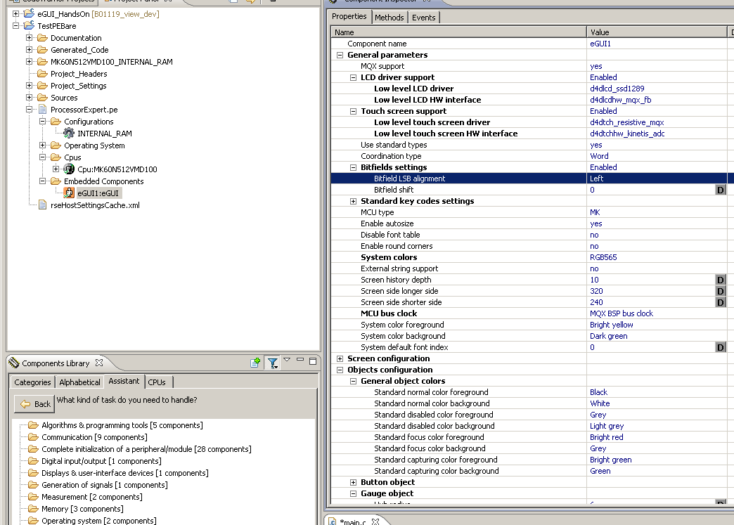
eGUI Processor Expert integration (alpha version)
All Configuration options
eGUI Bean –configuration
(d4d_usr_cfg.h)
Notes:
Processor expert helps to create all customization

Slide 14
Processor Expert + eGUI integration
Integration benefits:
Support of bare-metal applications directly within one product.
eGUI portability to all platforms supported by Processor Expert.
Reuse of Processor Expert logical device drivers as the eGUI HW abstraction layer.
Easy support and distribution of eGUI configurations for development board using component templates.
Easy migration from one MCU to another.
Notes:
Easy migration to other MCU

Slide 15

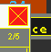

Round corners support
The eGUI version 2.00 brings round corners support. The round corners add to the final application softer appearance.
The eGUI screen and all objects has add new declaration macro to create round corners. For example:
D4D_DECLARE_BUTTON
and D4D_DECLARE_RBUTTON
Examples
Normal style
Round style
Button
Label
Slider
Screen
Notes:
All objects support natively round corners
The helps achieve softer appearance of final application

Slide 16
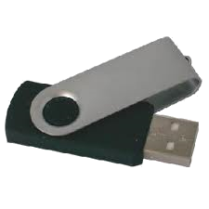
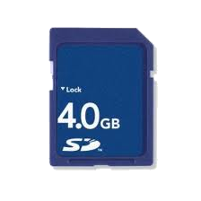
eGUI data storages
Internal
All data stored in MCU Flash
Fast and easy access
External
Data are stored in external file system (USB Flash Disk, SD card, …)
Save MCU Flash
Allow multiple language, graphic skins
Notes:
eGUI have two types of data storages
Internal / external

Slide 17
Supported low level drivers
LCD
SSD1289
FSA506
LGDP4531
Frame buffer
Touch screen
Analog resistive
Digital TSC2046
CR TOUCH
SPI, SWSPI, FlexBus, Parallel GPIO 8080, Parallel GPIO 6800, MQX_SPI, K70, PXD, MQX_FlexBus
S08_ADC, S12_ADC, Kinetis_ADC
Notes:
4 base LCD controllers drivers
Lot of HW communications driver
Basic resistive touch screen driver
It can also use native MQX drivers

Slide 18
eGUI Documentation and Downloads
www.freescale.com/egui
eGUI User Manual – DRM116
eGUI Image Converter Utility User Manual – EGUICUG
eGUI Fact Sheet - EGUIFS
Source code and examples
eGUI Video - http://www.towergeeks.org/video/tower-lcd-module-in-action
eGUI at FTF - http://www.youtube.com/watch?v=LOI8ATmgc48&feature=player_embedded#!
Notes:
All information what you need to start with eGUI you can find and download www.freescale.com/egui

Slide 19
Agenda
Introduction
SW structure
Graphics objects
Support software
Extras
eGUI
Software structure

Slide 20
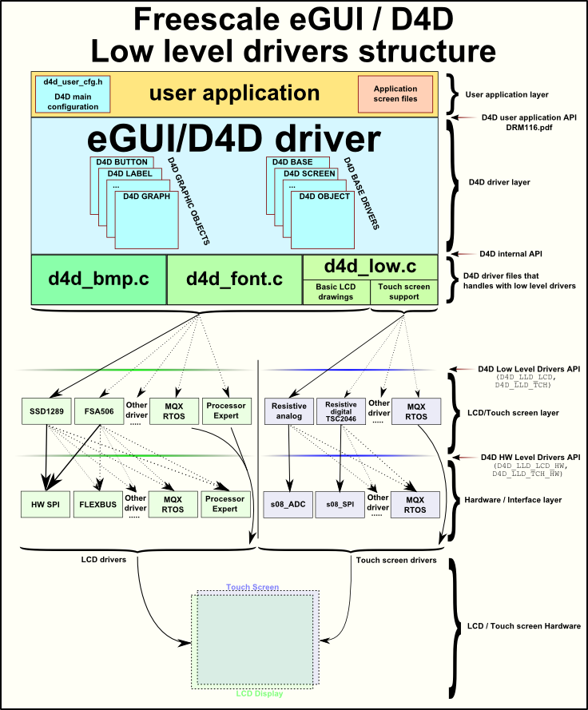
eGUI Structure
The eGUI structure is divided into two groups:
High level – platform independent layers
Low level – HW interaction layers
eGUI High Level
eGUI Low Level
(HW interaction)
Notes:
eGUI driver is divided on graphic stack and low level drivers(HW interaction)

Slide 21
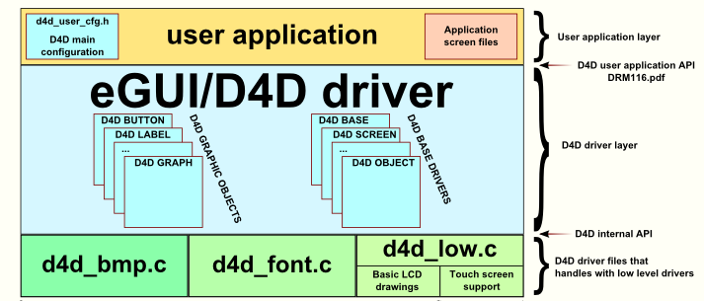
eGUI High Level Structure - independent on HW
User application layer – user code base
D4D driver layer – main code base of eGUI
Graphic object code base (D4D_BUTTON, D4D_LABEL etc.)
Interaction layer with low level drivers
Notes:
Application layer subdivide
eGUI base driver sub layer
Low level interaction sub layer

Slide 22
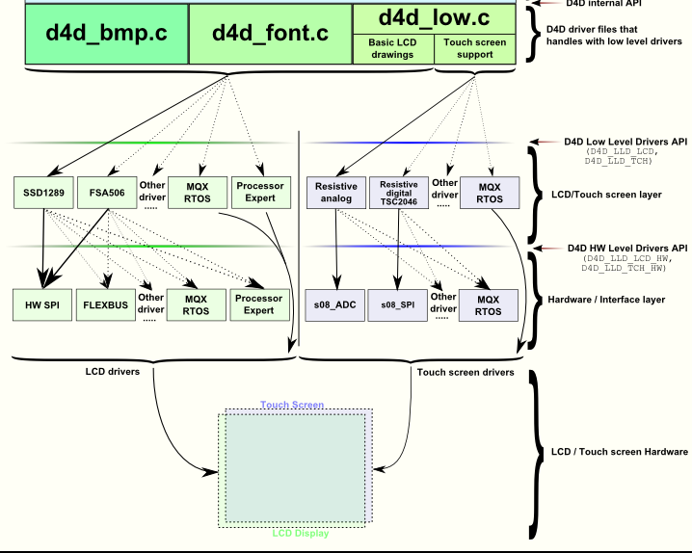
eGUI Low Level Structure – HW depended
Divided into two layers
LCD / Touch screen Controller Layer – handles the needs of different LCD controllers and touch screen read methods
Hardware interaction layer – service the interaction of LCD/Touch screen controller driver with HW.
Notes:
The eGUI low level drivers structure allows any combination of LCD/touch screen type and their HW connections. It also fully support any other drivers like PE or MQX

Slide 23
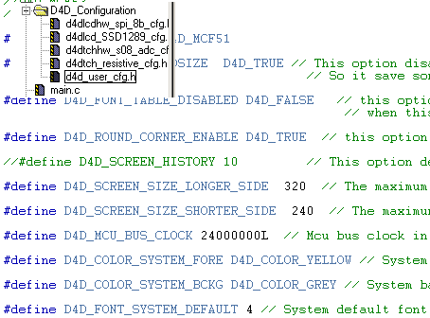
eGUI user customization
Selection of low level drivers corresponding to used hw
Setup of system settings
Customize default behavior and visual aspect of screen and widgets
MUST BE setup for each new application
Notes:
All eGUI driver can be fully customized by configuration file.
The file is part of application

Slide 24
D4D_SCREEN
The basic item of D4D structure is SCREEN
The d4d_screen container represented the real one screen showed on LCD
The screen contains:
list of all used objects on screen
functions bodies:
OnInit – One time called function with first use of screen
OnActivate – Function called with each activation of screen
OnDeactivate – Function called before deactivation of screen
OnMain – Function is called periodically when screen is active
OnObjectMsg - Function is called with all system messages of this screen
The screen functions are designed to simplify the application code

Slide 25
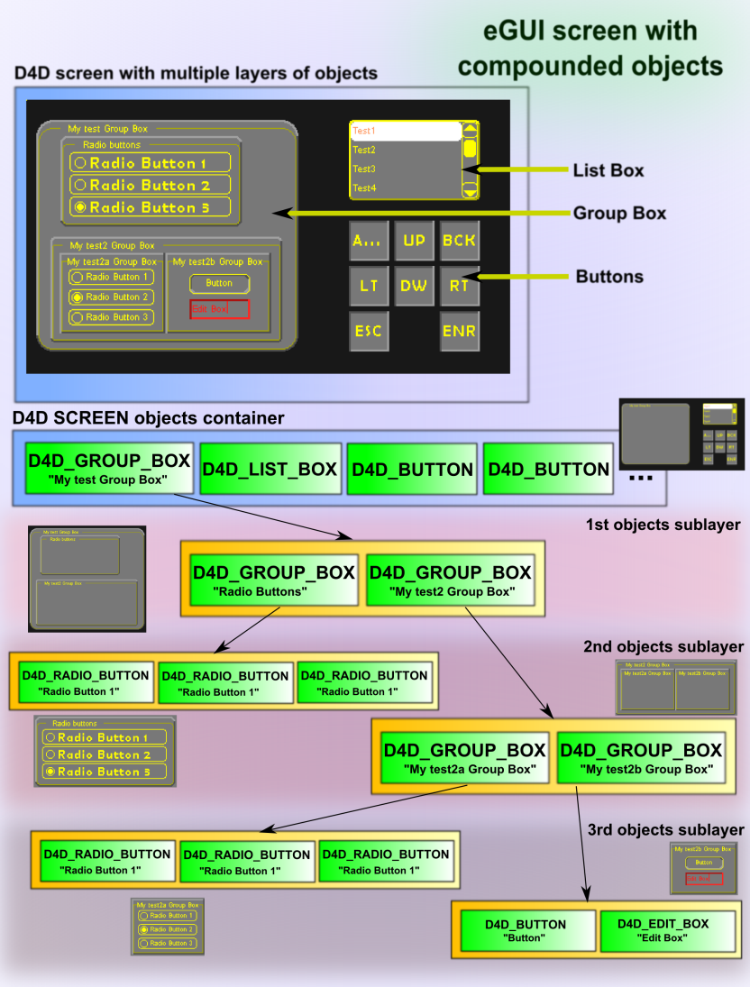
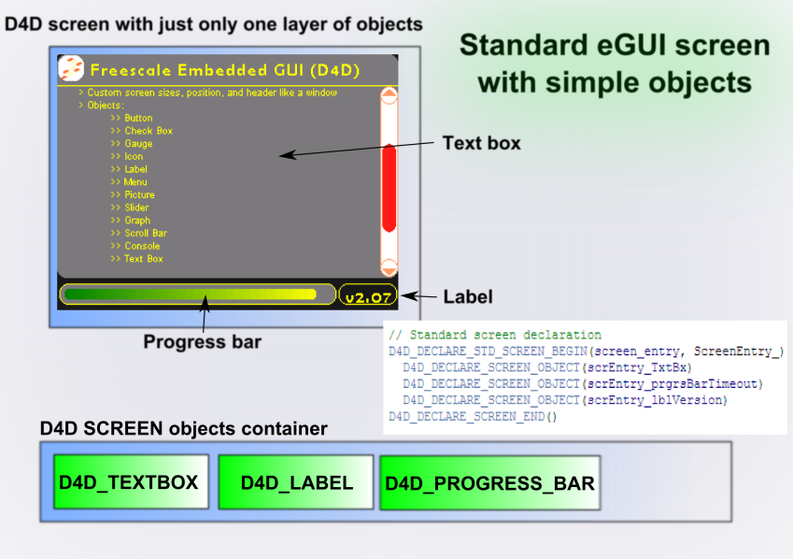
Compounded objects
New feature since version 3.00
Objects can has children / parents
Allows do better arrangement of objects

Slide 26
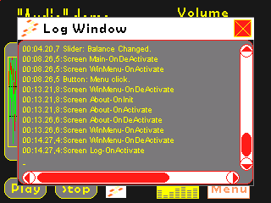
Screen history
The eGUI contains screens history buffer that simplify managing the screen switching.
Activate screen
Buffer depth
Empty
Escape screen
Features:
Activate screen
Escape screen
Replacing screen in history
Support standard key inputs(ENTER, ESC)
Empty
Log Screen
Empty
Menu Screen
Main Screen
Notes:
eGUI brings unique screen history buffer that help simplify the creating the control applications.
Better support of escape screen (ESC key)

Slide 27
Agenda
Introduction
SW structure
Graphics objects
Support software
Extras
eGUI
Graphic objects

Slide 28
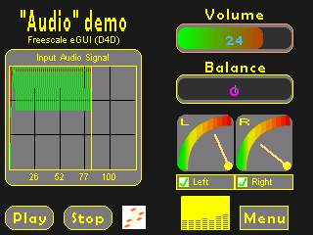

D4D_BUTTON object
The D4D_BUTTON(D4D_RBUTTON) is intended to be used as standard (text / picture) button.
Features:
Variable position, size, text position and corners radius
3D appearance option
Title text that can be run-time changed
Underline, strike through and transparent text option
Disable/enable capability
Two background bitmaps for focused and normal state
Touch screen support
OnClick callback function to simplify the user application
Notes:
Typical epresentant

Slide 29
D4D_CHECKBOX (RADIO BUTTON)object
The D4D_CHECKBOX(D4D_RCHECKBOX) is intended to be used as standard (text / picture) check box or radio button.
Features:
Variable position, size and corners radius
Title text can be underline, strike through and transparent
Disable/enable capability
Touch screen support
OnChange callback function to simplify the user application

Slide 30

D4D_GAUGE object
The D4D_CHECKBOX(D4D_RCHECKBOX) is intended to be used as standard (text / picture) check box.
Features:
Variable position, size, HUB position, pointer length and corners radius
Title text can be underline, strike through and transparent
Disable/enable capability
Background bitmap that allows making various gauges
OnChange callback function to simplify the user application

Slide 31
D4D_PICTURE object
The D4D_PICTURE(D4D_RPICTURE) is intended to be used to show picture on screen.
Features:
Variable position, size and corners radius
Disable/enable capability

Slide 32


D4D_ICON object
The D4D_ICON(D4D_RICON) is intended to be used as standard icon. The specialty of this object is bitmap array that allows simply change pictures on screen and simply animation.
Features:
Variable position, size, text position and corners radius
Title text can be underline, strike through and transparent
Disable/enable capability
Bitmap array (animation capability)
OnChange callback function to simplify the user application
Icon

Slide 33


D4D_SLIDER object
The D4D_SLIDER(D4D_RSLIDER) is intended to be used as standard slider. The slider is using to show numerical information in analog appearance and as input object.
Features:
Variable position, size, text position and corners radius
Title text that can be run-time changed
Underline, strike through and transparent text option
Disable/enable capability
Touch screen support
Automatic “cross color” bar capability
OnClick callback function to simplify the user application

Slide 34
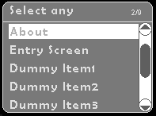
D4D_MENU object
The D4D_MENU(D4D_RMENU) is intended to be used as standard menu option.
Features:
Variable position, size, text position and corners radius
Title and items text can be underline and strike through
Title and items icons
Side scroll bar capability for lager menu
Disable/enable capability
Touch screen support
OnClick callback function to simplify the user application

Slide 35
D4D_LABEL object
The D4D_LABEL(D4D_RLABEL) is intended to be used to show simple text on screen.
Features:
Variable position, size and corners radius
Text can be runtime changed
Disable/enable capability
Text align—Left, center, top, bottom, and right
Underline, strike through and transparent text option

Slide 36
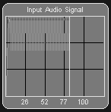
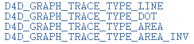
D4D_GRAPH object
The D4D_GRAPH(D4D_RGRAPH) is intended to be used to show graph on screen.
Features:
Variable position, size and corners radius
Title header + custom grid
Labels on both axes + scalable axis X
Disable/enable capability
Multiple traces of the graph
Variable colors and styles of traces
#1
#2
#...
Notes:
Add a second picture with focus rectangle and round corners!

Slide 37
D4D_SCROLL_BAR object
The D4D_SCROLL_BAR(D4D_RSCROLL_BAR) is intended to be used to show scroll bar. The scroll bar is used in some objects(D4D_MENU, D4D_CONSOLE, etc.) as child object.
Features:
Variable position, size and corners radius
Horizontal and vertical orientation
Runtime selectable maximum, minimum, step, and page parameters
Disable/enable capability
OnChange callback function
Notes:
Add a second picture with focus rectangle and round corners!

Slide 38
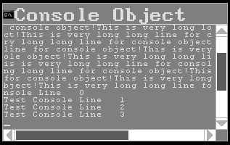
D4D_CONSOLE object
The D4D_CONSOLE(D4D_RCONSOLE) is intended to be used to show console with standard functionality.
Features:
Variable position, size and corners radius
Horizontal and vertical scroll bars (if needed)
Cursor function
Disable/enable capability
Standard key controls

Slide 39
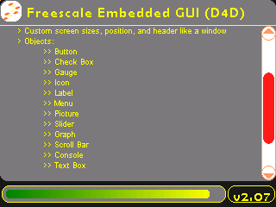
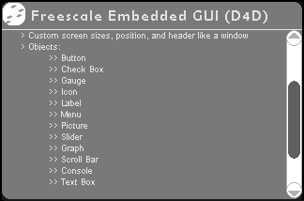
D4D_TEXTBOX object
The D4D_TEXTBOX(D4D_RTEXTBOX) is intended to be used to show multi line text with basic formatting capability.
Features:
Variable position, size and corners radius
Optional title bar
Vertical scroll bar (if needed)
Word detection and long word wrapping
Tabulators and new line support
Disable/enable capability
/t
/n

Slide 40
D4D_PROGRESS_BAR object
The D4D_PROGRESS_BAR(D4D_RPROGRESS_BAR) is intended to be used as standard progress bar. This is very simple object that is designed only as information bar about progress.
Features:
Variable position, size and corners radius
Disable/enable capability
Automatic “cross color” bar capability

Slide 41
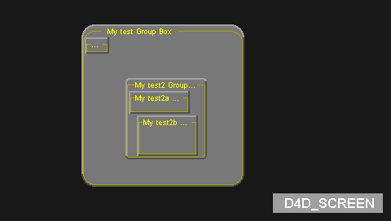
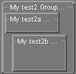
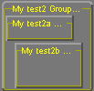
D4D_GROUP_BOX object
The D4D_GROUP_BOX(D4D_RGROUP_BOX) is intended to be used as container for objects for better graphic arrangement.
Features:
Variable position, size and corners radius
Optional title text
Bevels
Disable/enable capability

Slide 42
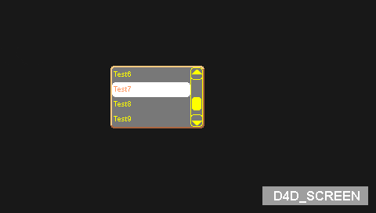
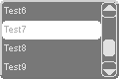
D4D_LIST_BOX object
The D4D_LIST_BOX(D4D_RLIST_BOX) is intended to be used as standard list box object.
Features:
Variable position, size and corners radius
Items text can be underline and strike through
Disable/enable capability
Side scroll bar capability for lager menu
Touch screen support
OnChange callback function to simplify the user application

Slide 43
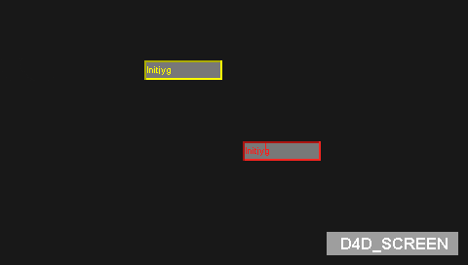
D4D_EDIT_BOX object
The D4D_EDIT_BOX(D4D_REDIT_BOX) is intended to be used as standard edit box object.
Features:
Variable position, size and corners radius
Text can be underline and strike through
Disable/enable capability
Cursor capability
Touch screen support
OnChange callback function to simplify the user application

Slide 44
Agenda
Introduction
SW structure
Graphics objects
Support software
Extras
Support software

Slide 45
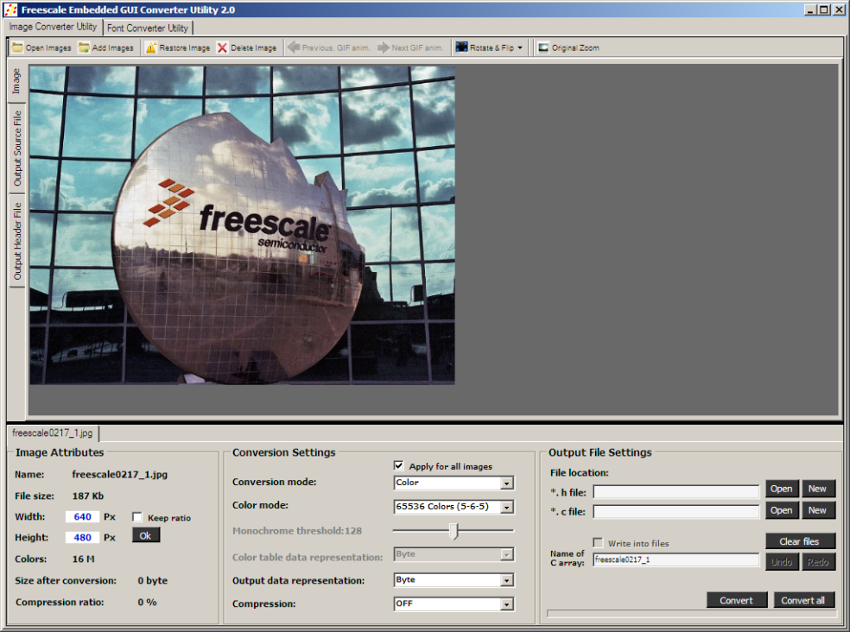
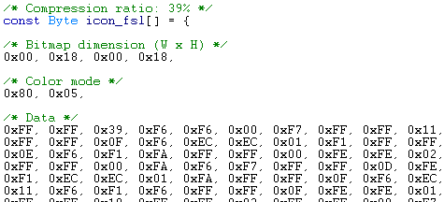
eGUI converter utility - bitmaps
Convert bitmap images into “C” arrays which eGUI can display on LCD panels
Supported eGUI Formats:
16M / 65K / 256 colors
2-4-16-256 colors with palette
Binary output support
All of these formats can be compressed

Slide 46
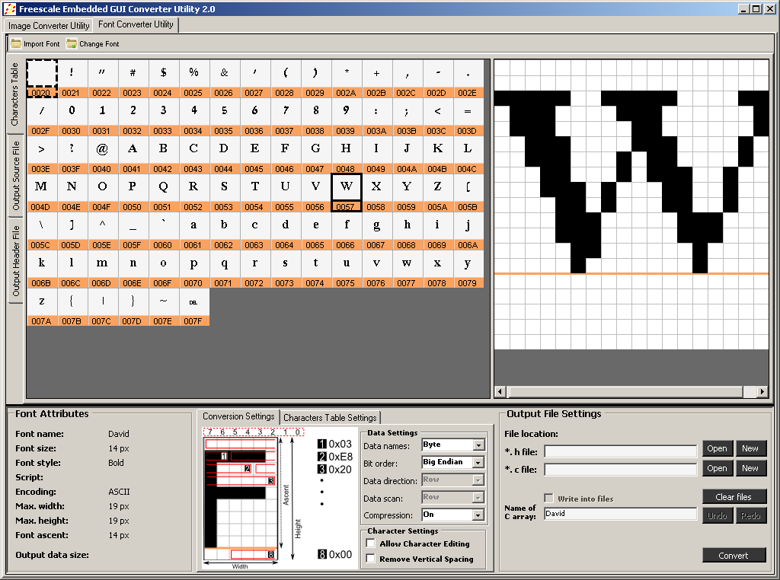
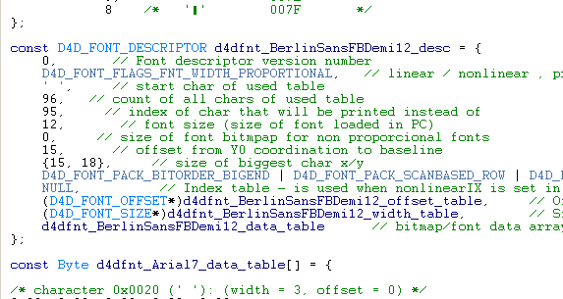
eGUI converter utility - fonts
Convert fonts into “C” arrays which eGUI can display on LCD panels
Converts Windows fonts
Allows editing of individual characters
Allows creating user chars set
UNICODE support
Binary output support

Slide 47
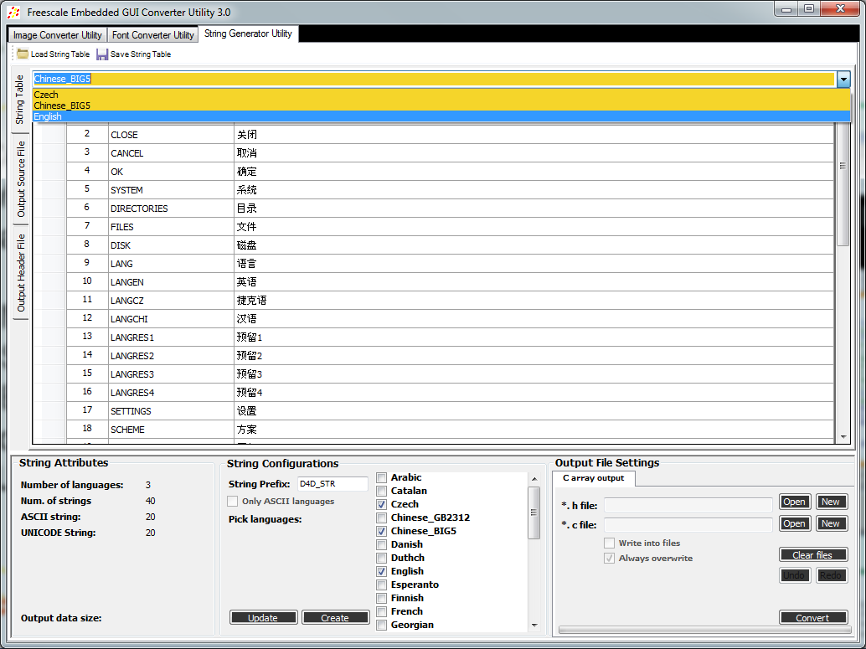
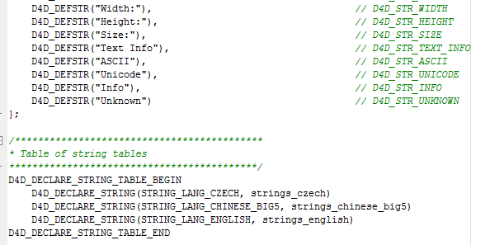
eGUI converter utility – strings
Convert strings into “C” tables which eGUI can display on LCD panels
Multi language suuport
Save/Load project support
Export all used chars to font converter
UNICODE support

Slide 48
Agenda
Introduction
SW structure
Graphics objects
Support software
Extras
Extras

Slide 49
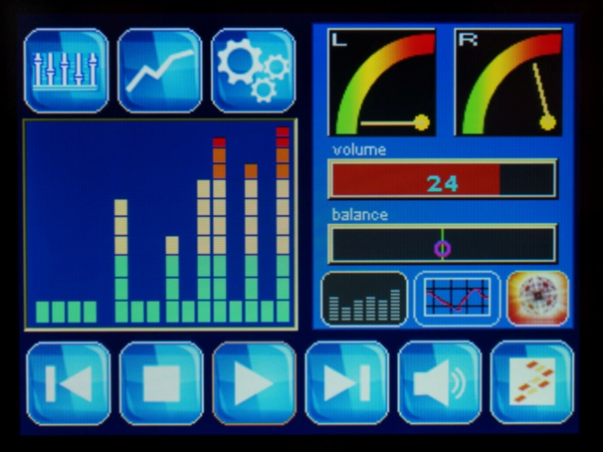
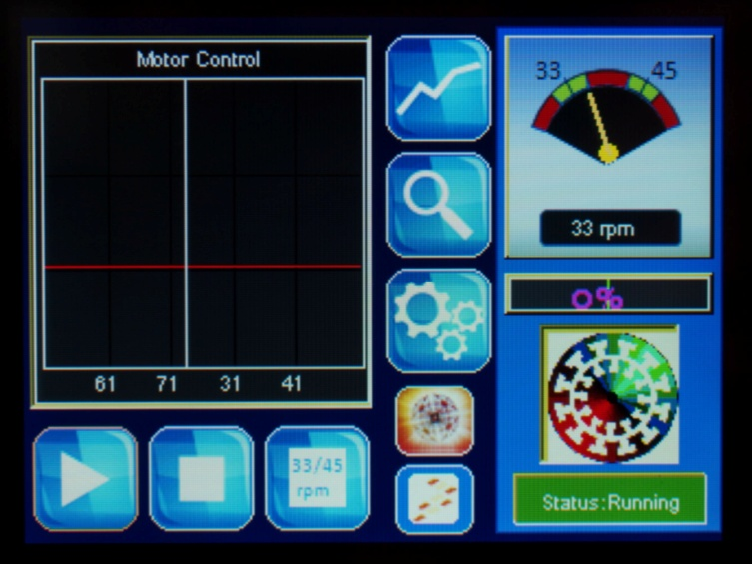
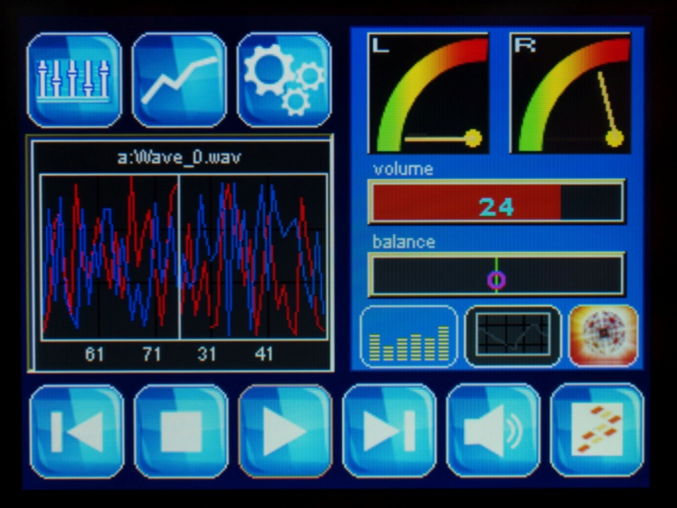
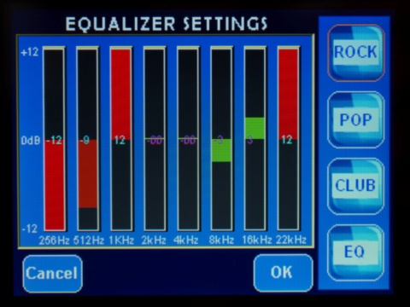
Real application – Freescale Kinetis Turntable Demo

Slide 50
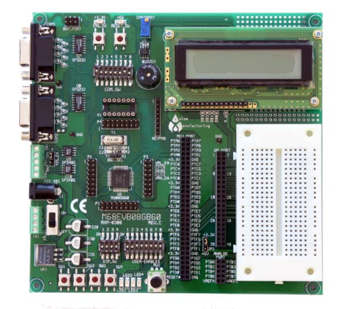
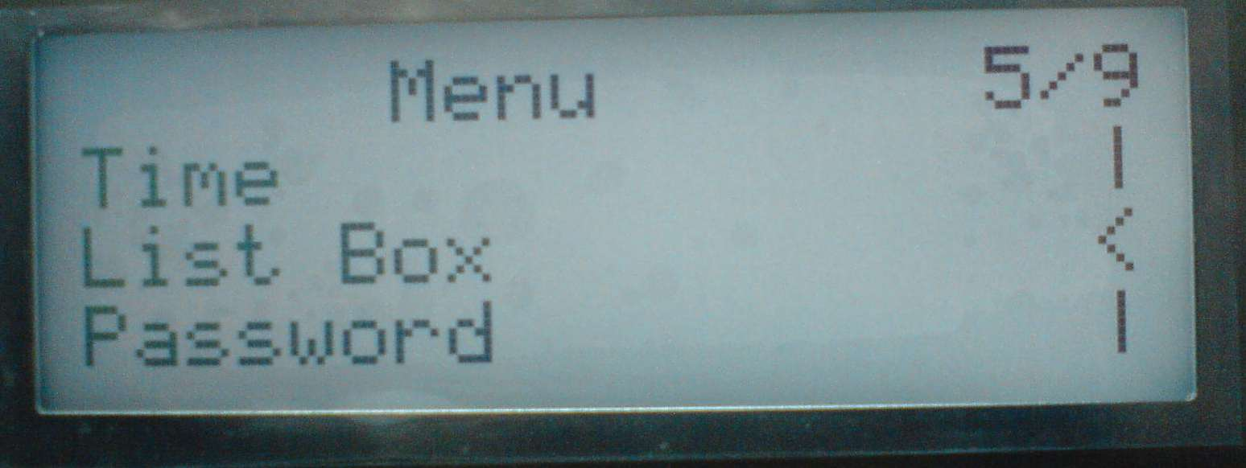
AN4263 – Modification of the eGUI for alphanumerical LCD
There is exist modification of eGUI driver for alpha numerical displays simply described in AN4263.
Same features as eGUI
Without touch screen, colors etc
Support HD44780 LCD driver
HW cursor support
User char tables support
What you learn in eGUI, you can reuse in D4CD

Slide 51
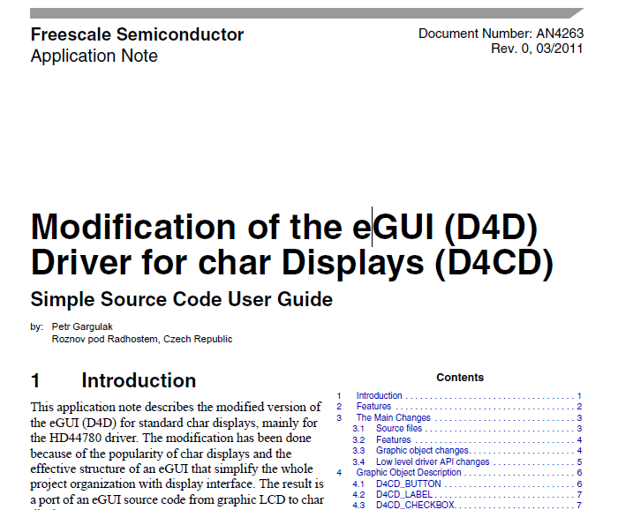
AN4263 – Modification of the eGUI for alphanumerical LCD
List of objects
Button
Check box and user handled radio button
Label
Menu
Number
ListBox
User defined objects:
Time
Date
Password

Slide 52
Agenda
Introduction
SW structure
Graphics objects
Support software
Extras
Add new low level driver
Extras – Add new low level driver

Slide 53
Recap - eGUI Low Level Structure
Divided into two layers
LCD / Touch screen Controller Layer – handles the needs of different LCD controllers and touch screen read methods
Hardware interaction layer – service the interaction of LCD/Touch screen controller driver with HW.

Slide 54

Add new low level driver
The each group type of low level drivers(LCD, LCD HW, TCH, TCH HW) has added in the file structure the driver templates
This templates are designed to speed up the creation of new low level drivers

Slide 55
Add new low level driver – progress #1
If you want to create the new LCD driver for “LCD1234” LCD controller
First of all the right template should be copy and rename (complete folder template->lcd1234) in some directory to keep right file structure of eGUI
In new created the folder, all files should be renamed(d4dlcd_template.c / h to d4dlcd_lcd1234.c / h )

Slide 56

Add new low level driver – progress #2
At the moment the new low level drivers are prepared to add to project
As next step will be rename all prepared source code in all new files. The key words are(case sensitive):
“TEMPLATE “ => ”LCD1234”
“Template” => “Lcd1234”
“template” => “lcd1234”

Slide 57

Add new low level driver – progress #3
New driver name to use in d4d_usr_cfg.h file
d4dlcd_lcd1234.c
New Driver API functions prototypes
New driver API structure interface

Slide 58

Add new low level driver – progress #4
Fill up all API functions in new created driver
In our case mainly:
Init
SetWindow
SetOrientation
Send_PixelColor
Delay_ms
And select new driver in d4d_usr_cfg.h
Just fill up your code

Slide 59
Q&A

